Slide 1
Striving for Tradition and Change: Fluid Dynamics and Music Education
Lauren Kapalka Richerme
Indiana University Jacobs School of Music
MayDay Group Colloquium 26
June 19, 2014

Slide 2
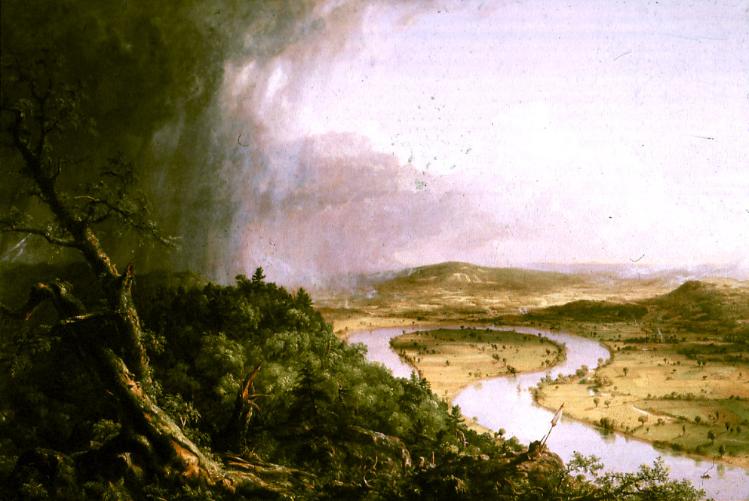
“The Oxbow” (1836) by Thomas Cole

Slide 4
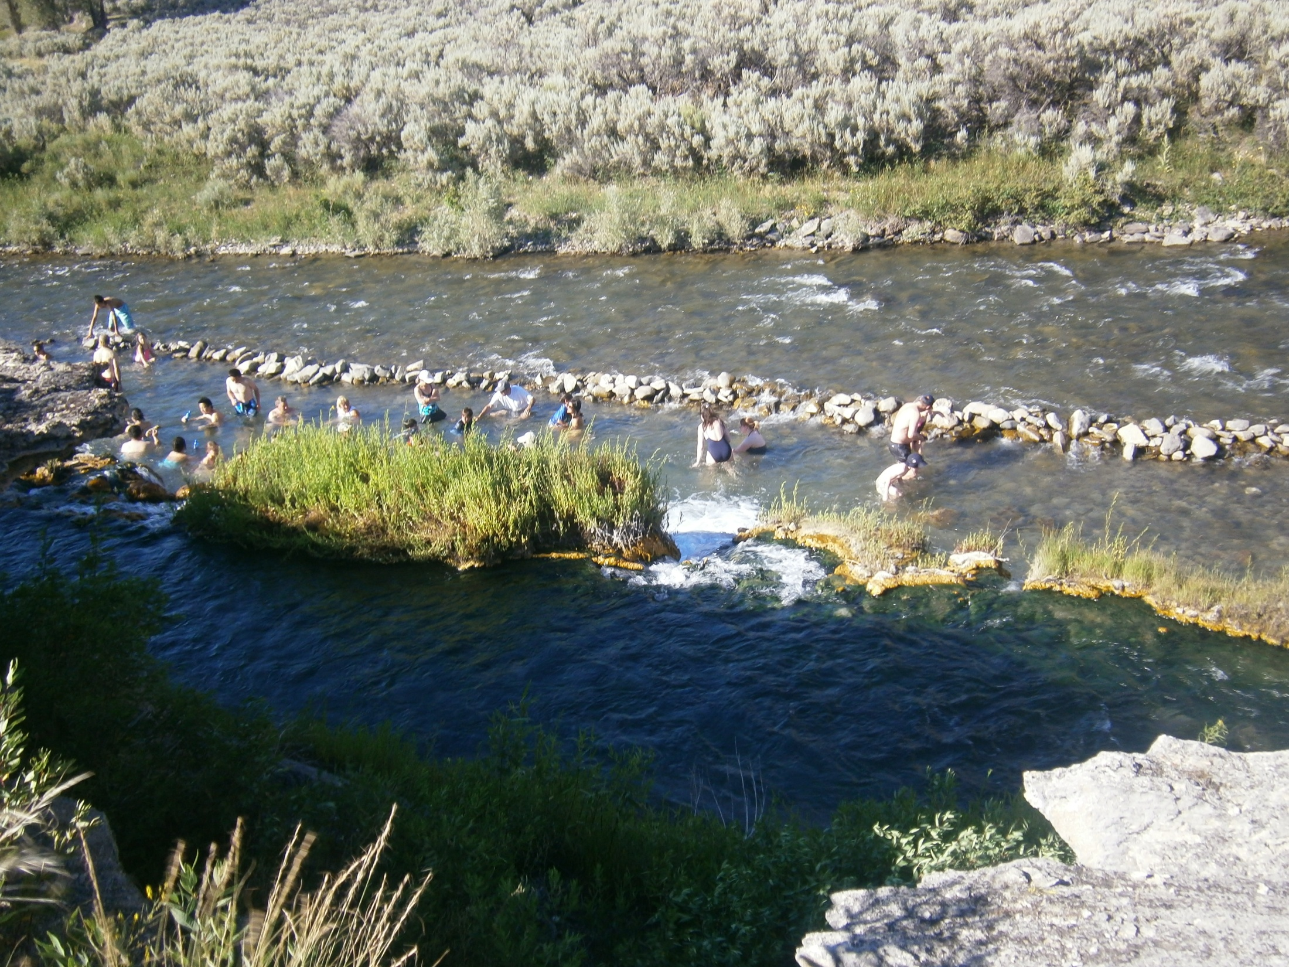

Slide 5
Snowmelt
Hot Springs

Slide 6
Tradition or/and Change
“Traditional ensembles” (NAfME, NCCAS)
“One wonders whether our profession's resistance to change is a direct result of the limitations in the musicianship we have been taught” (Kratus, 2007)
“Change is a worthy goal” (Williams, 2011)
“Tradition and change” (Jorgensen, 2008)

Slide 7
Problems with Contemporary Discourse
Separate rather than interconnected
Universal ideas independent of context
Stagnant

Slide 8
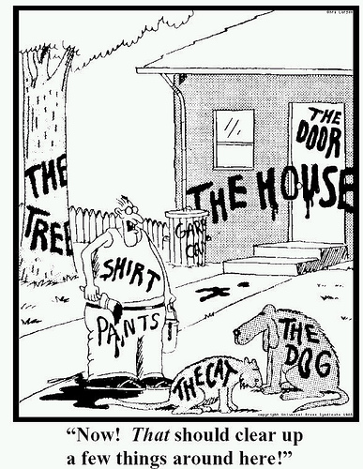
Analyzing “Tradition” and “Change”
“Poststructuralism is a set of experiments on texts, ideas and concepts that show how the limits of knowledge can be crossed and turned into disruptive relations” (James Williams, 2005)
“Not against this and for that - once and for all. . . . It is for the resulting positive disruption of settled oppositions” (James Williams, 2005)

Slide 9
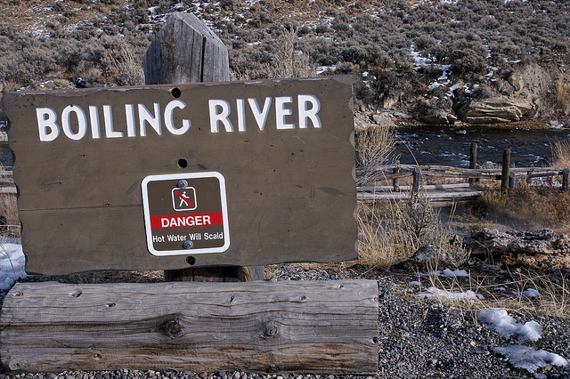
Outline
Integrated nature of tradition and change
Factors might cause an individual to use the labels “tradition” or “change”
Alternative ways of engaging with tradition and change

Slide 10
“We are a part of that nature that we seek to understand” (Barad, 2007)

Slide 11
“We too are part of the world’s differential becoming” (Barad, 2007)

Slide 12
Tradition Integrated With Change
Tradition “The action of transmitting or ‘handing down’. . . from one to another, or from generation to generation” (Oxford English Dictionary)
“The achievements of the past provide the only means at command for understanding the present. . . . The sound principle that the objectives of learning are in the future and its immediate materials are in the present experience can be carried into effect only in the degree that present experience is stretched, as it were, backward” (Dewey, 1938)

Slide 13
Tradition Integrated With Change
“Those taking part in a musical performance are in effect saying—to themselves, to one another, and to anyone else who may be watching or listening— This is who we are” (Small, 1998)
Change “Substitution of one thing for another; succession of one thing in place of another” (Oxford English Dictionary)
“Growing is not something which is completed in odd moments; it is a continuous leading into the future” (Dewey, 1916)

Slide 14
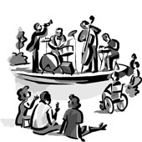
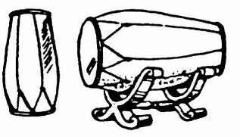
A
A’
Intervening Experiences
Prior Experiences
Prior Experiences

Slide 15
Evolving, Contextually-dependent Definitions of Tradition and Change
Past experiences
Timescale of the observation
Focus of his or her attention

Slide 16
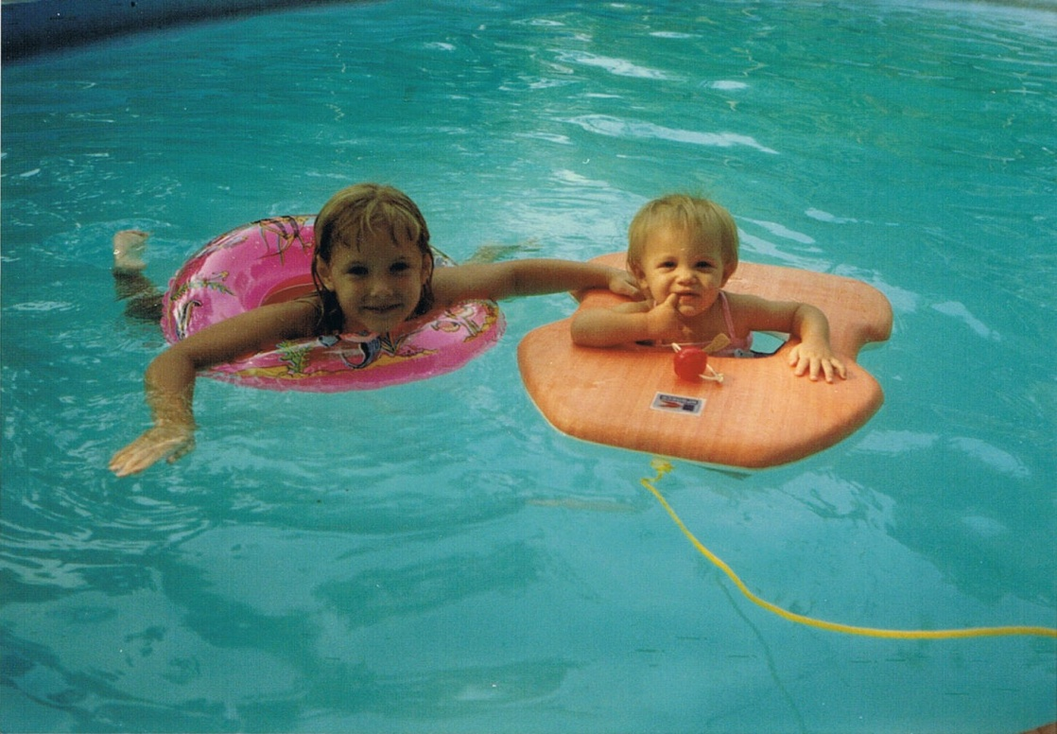
Past Experiences

Slide 17
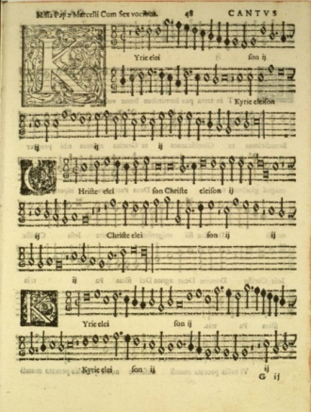
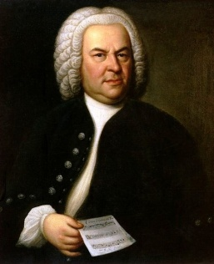
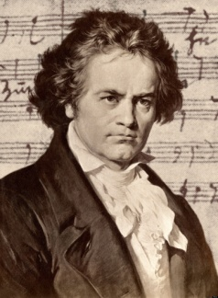
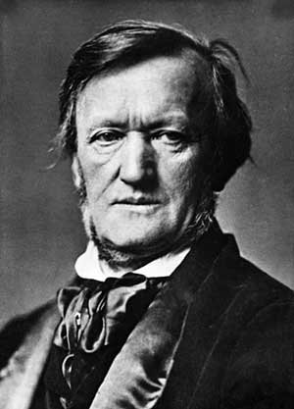
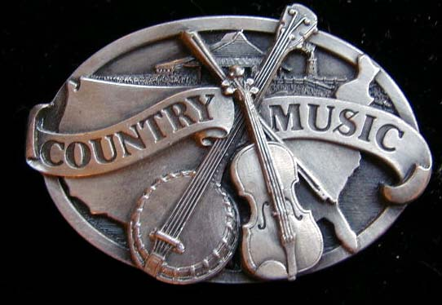
For Lauren Today
90’s Popular Music
Baroque orchestral
Classical orchestral
Romantic orchestral
Renaissance music
Baroque vocal music
Contemporary country
Primarily Traditional
Primarily
Change-Oriented

Slide 18
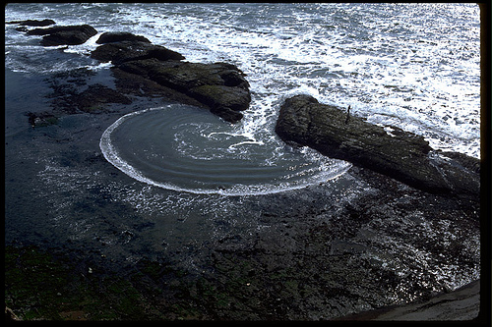
Diffraction (Barad, 2007)
“The way waves combine when they overlap and the apparent bending and spreading of waves that occurs when waves encounter an obstruction”
“”Subject and object do not preexist as such, but emerge through intra-actions.”
“intra-action”

Slide 19
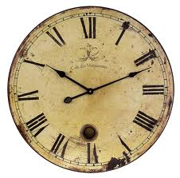
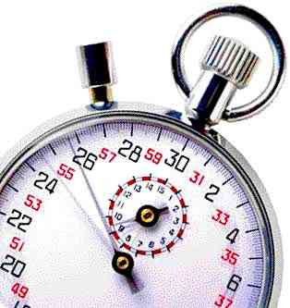
Timescale of Observation

Slide 20
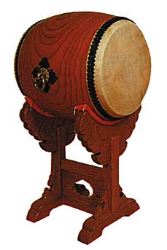
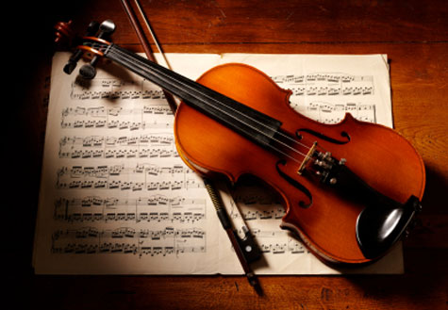
Primarily Change-Oriented
Primarily Traditional

Slide 21
Focus of One’s Attention

Slide 22
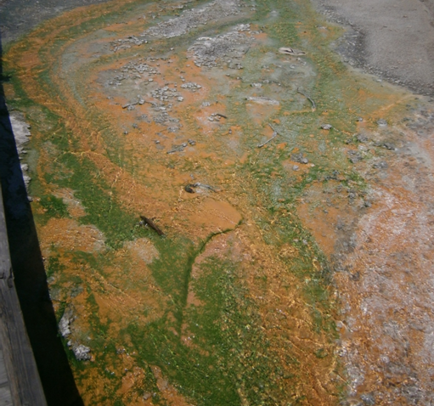

Slide 24
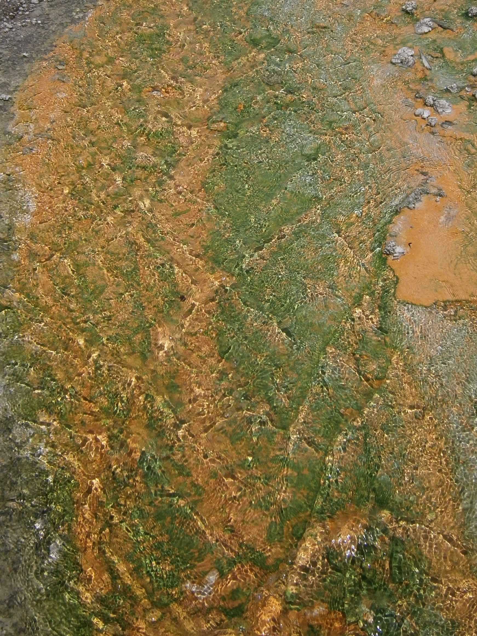

Slide 25
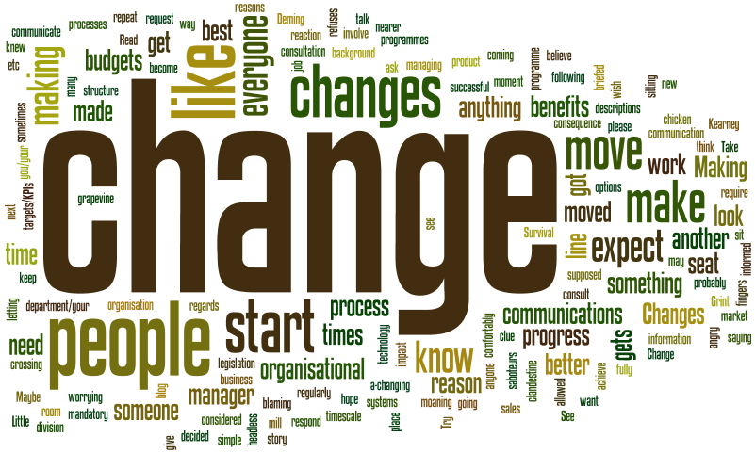
Integrated, Evolving Processes
“The very nature of change and the possibilities for change changes in an ongoing fashion as part of the world’s intra-active dynamism” (Barad, 2007)
An “innovative” musical practice devoid of context does not exist

Slide 26
Tradition and Change in Music Education
“Reality is an ongoing dynamic of intra-activity” (Barad, 2007)

Slide 27
In what confluence of tradition and change do
we and our students currently thrive?
Flourishing at the Confluence
In what other integrations might we also flourish?

Slide 28
Exploring Change and Tradition
Physical movement
Change in flows
Ripples of others

Slide 29
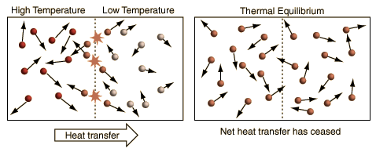
Physical Movement

Slide 30
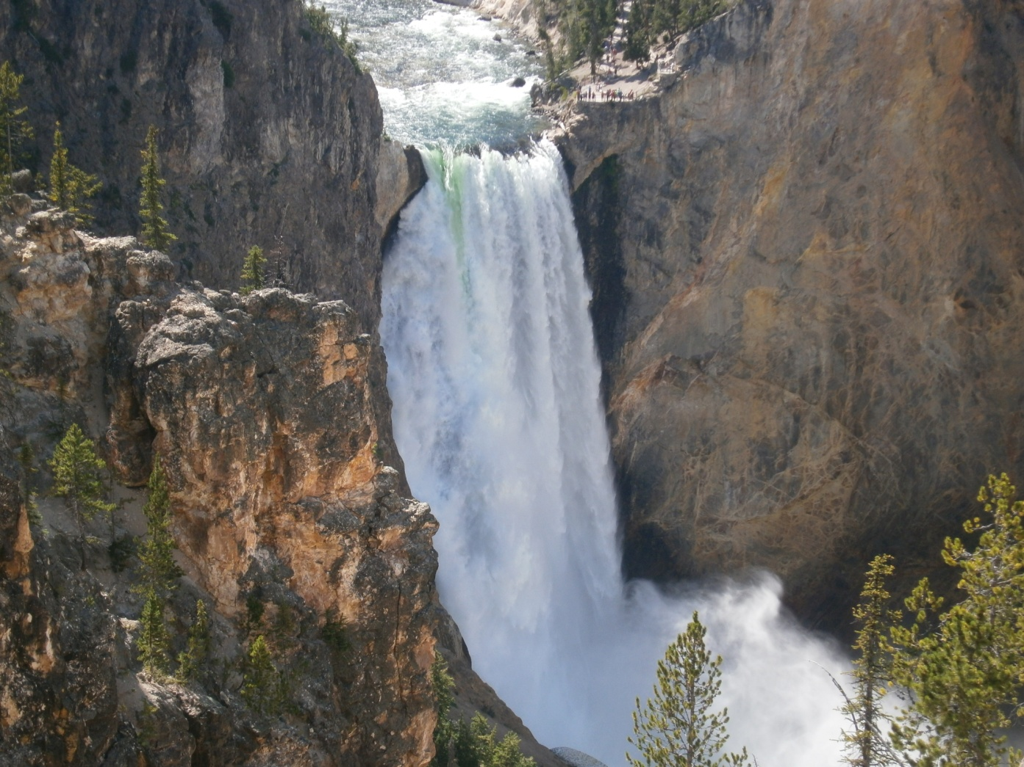
Change in Flows
Words often fail to change practice (Bourdieu, 1972)
Practice itself is not a logical system (Bourdieu, 1972)

Slide 31
Interacting with the Flows of Others
“How can music educators consider students’ experiences, interests, and music-making outside of school to facilitate meaningful musical and educative experiences?”
Practices and problems

Slide 32
Tradition, Change, and MayDay
“Musical activity develops out of an emergent synergy of change and tradition within human contexts and communities of practice”
(MayDay Group Action Ideal III)

Slide 33
How can we work to make the practices detailed at this conference understood neither purely as “traditions” or “changes” but rather an ongoing evolution of the two?
How might the MayDay Group website and the journal Action, Criticism and Theory for Music Education offer more places for evolving dialogue regarding individual visions of primarily traditional and primarily change-oriented music education practices?
How might members of the MayDay group better engage collegiate teacher educators, K-12 educators, and practitioners from diverse disciplines in experiences and experiments focused on the unfolding integration of tradition and change?

Slide 34
Confluence and Motion
“Music education should
NEVER be stagnant!”

